Slide 1
multiScan100 Customer Presentation
Strategic Product Management
December 2022

Slide 2
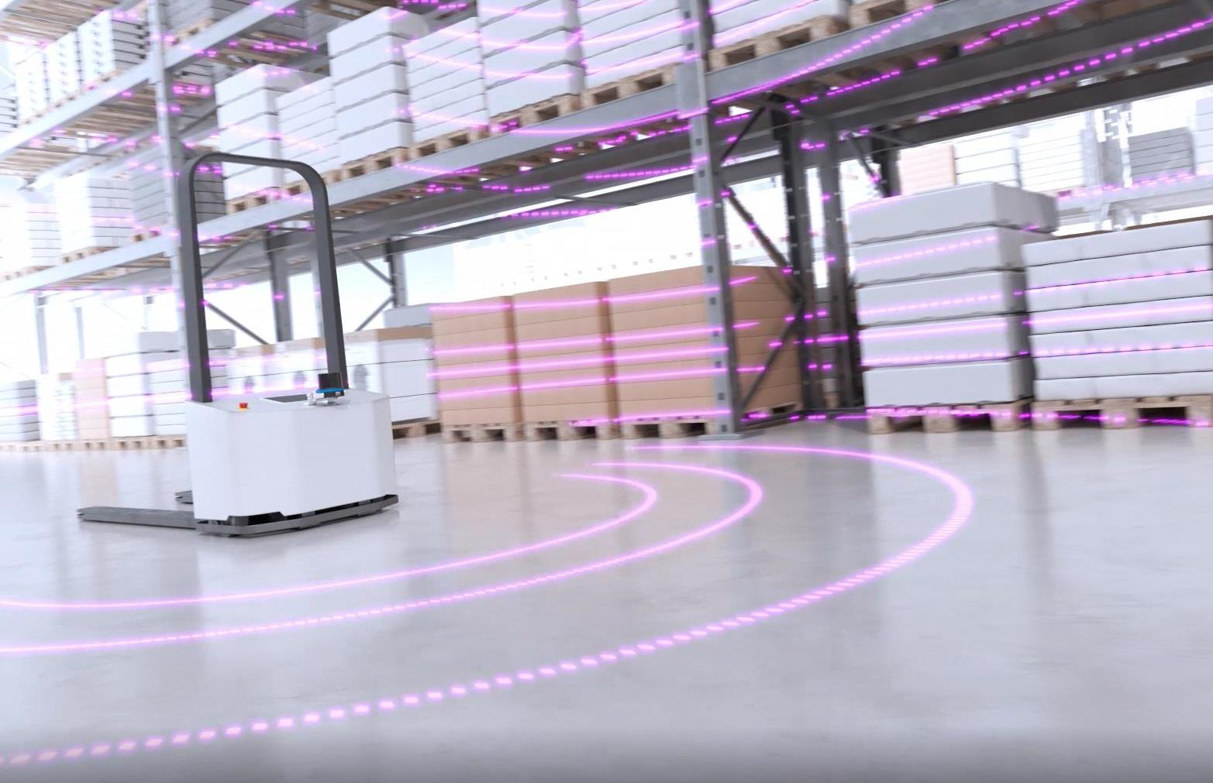
multiScan100 Detect, localize and secure - all in one

Slide 3
Content
Applications
Fields of applications
Technology
Focus application
LiDAR vs. Camera
Product
Highlights
Product positioning
USP description
Features / Benefits
Technology
Protective field concept
Variants
Configuration & Diagnostics
Accessories

Slide 4
1. Applications
Fields of applications
Technology
Focus application
LiDAR vs. Camera

Slide 5
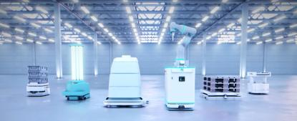
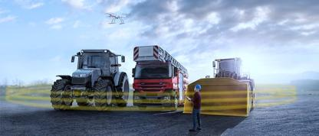
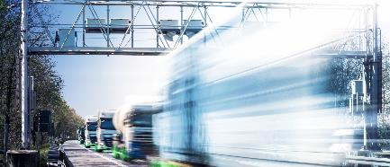
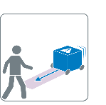
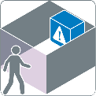
Fields of applications
multiScan100
Autonomous Guided Vehicles and service robots
Mobile outdoor automation
Stationary applications
Anti-Collision and Environmental Perception
Anti-Collision and Environmental Perception
Access protection
3D Environmental Perception, Localization and Mapping
Sensor mounted on the vehicle to support autonomous driving
Anti-Collision due to environmental perception with broad FOV and 16 scan layers
3D Environmental Perception in harsh outdoor environment
Sensor can detect environment and thus control the driving path
Sensor is constructed to withstand the harsh conditions with e. g. high shock and vibration resistance and IP rating
Sensor can be used to monitor the presence of objects/persons in a defined volume:
for security applications (e. g. monitor access to buildings)
Monitor traffic situations

Slide 6
Technology
3D LiDAR
The multiScan100 is based on time-of-flight (TOF) technology
A laser pulse signal is sent out to the object
Laser pulse reflects at an object
The receiver element detects the reflected light
The time from sending to receiving the signal is measured and evaluated and calculated based on the speed of light
By spinning the measurement module and combining it with other measurement modules, a 3D point cloud is calculated
Object to be detected
t_{SO}
t_{OS}

Slide 7
Mobile Applications
multiScan100
3D Environmental Perception + Localization and Mapping
All in ONE device

Slide 8
Mobile Applications
multiScan100
3D Environmental Perception + Localization and Mapping
Upper layers
Upper +42.5° of the field of view
3D Environmental Perception with all layers
More layers looking in front and above the vehicle and not too many layers on the ground

Slide 9
Mobile Applications
multiScan100
3D Environmental Perception + Localization and Mapping
Lower layers
Lower -22.5° of the field of view for objects on ground level
Detection of smaller obstacles on the ground like fork tines or pallets
Lower layers are used for cliff detection or ramp inclination

Slide 10
Mobile Applications
multiScan100
3D Environmental Perception + Localization and Mapping
Two high-density layers
0.125° resolution: detect even small objects in far distances due to higher resolution
Horizontal, 0°: Ideal to use for localization and mapping (additional reflector recognition)
Upper, +35°: ceiling can be used for reference measurement since there are fewer changes as on the ground when e. g. racks are moved
Segmented data output, thus reduced latencies – less time blurring
Very good scan field flatness of ±0.5°

Slide 11
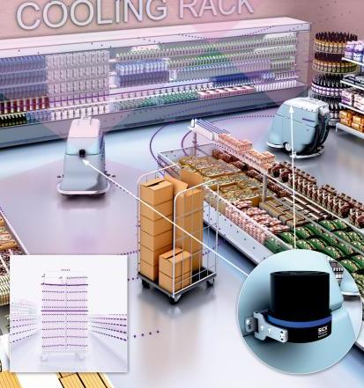
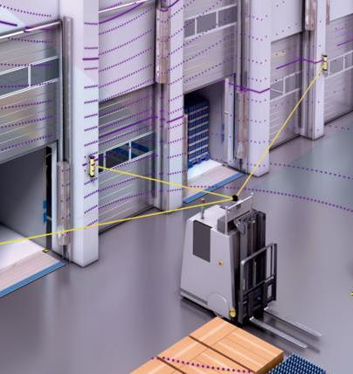
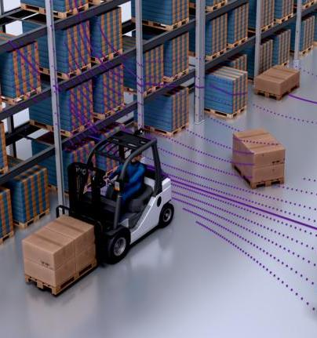
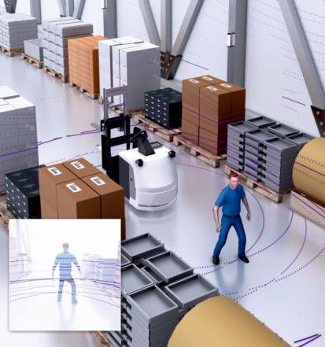
Mobile Applications
multiScan100 – Summary
3D Environmental Perception + Localization and Mapping
More information about the environment and higher efficiency thanks to the 3D point cloud
2D Localization based on Reflector information
0° High Resolution-Layer for Localization and Reflector recognition with a range up to 60 m
3D Object detection for Collision avoidance!
3D Environment perception and Collision avoidance based on a large FoV
Person detection and tracking
Higher availability with 3D detection of objects and persons

Slide 12
3D Environmental Perception + Localization and Mapping
All in ONE device
⅔ of the vFOV for anti-collision
Anti-collision of objects in the front
Anti-collision of hanging objects
0° & 35° horizontal high-resolution layer for
Accurate measuring data for navigation tasks
Detection of small objects in far distances
⅓ of the vFOV for:
Anti-collision of flat close to the ground obstacle, such as forklift tines or pallets
Cliff / ramp detection
Ground reference

Slide 13
Focus Applications
Camera vs. LiDAR
Why to use the multiScan100 3D LiDAR to solve the applications?
Unique combination of high-density horizontal layers and 3D point cloud
Two layers with 1/8° resolution to detect smaller objects in all distances and the chance to fulfill localization and mapping tasks
Rugged housing and design to suit rough ambient conditions
Variety of SW-Applications and Add-ons to serve customer-specific application
LiDAR vs. Camera – why does LiDAR win?
Bigger field of view (horizontal and vertical) – there is no camera with 360°
Higher ranges due to different technology
Higher robustness against ambient light conditions
High-density measurement data in horizontal scan layers
Increased distance accuracy due to better measurement noise behavior
multiScan100
Camera

Slide 14
2. Product
Highlights
Features / Benefits
Specification
Configuration & Diagnostics
Accessories

Slide 15
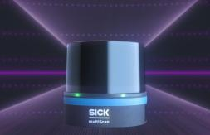
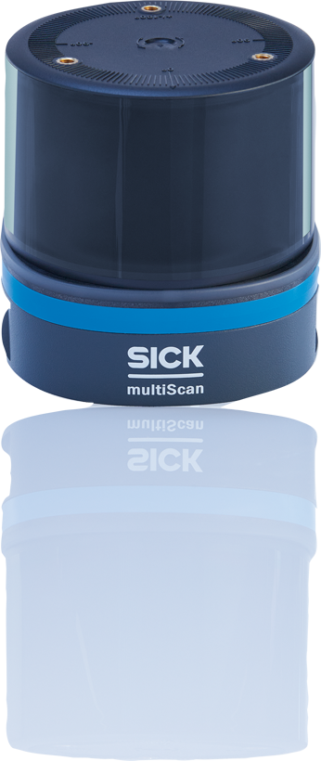
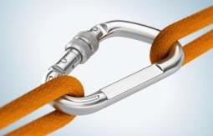
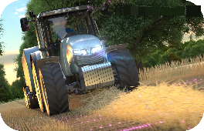
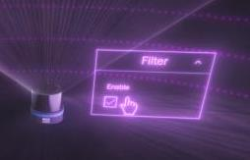
Highlights
multiScan100
compact
Broad field of view combined with high-density layers
Reliable
Reliable measuring data including multi-echo evaluation
Robust
Rugged design for outdoor environment
Customer Centric
Application-specific sensor setup

Slide 16
Features / Benefits
multiScan100
Features
Benefits
Compact
Broad field of view (360° x 65°) including two high-density layers with less angular resolution of 0.125° in one device
… enable to …
have best of both worlds: high-density layer for navigation and 3D point cloud of the surrounding.
reliable
High measurement accuracy with less measurement noise. Additional multi-echo technology to increase reliability
… lead to …
a proper identification of obstacles as well as a reliable navigation and mapping with the sensor.
Robust
Ruggedized design for rough ambient conditions: IP69k, Shock and Vibration resistance
… enables …
indoor and outdoor usage although having rough ambient conditions.
Customer Centric
Application-specific sensor setup: selectable measurement module, system plug, Apps and SW Add-ons
… result in …
best sensor fit for the required application by only paying for the functions which are really needed.

Slide 17
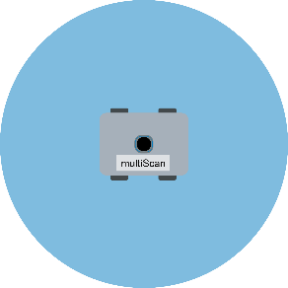
Features / Benefits
multiScan100
Compact
Broad field of view (360° x 65°) including two high-density layers with less angular resolution of 0.125° in one device
have best of both worlds: high-density layer for navigation and 3D point cloud of the surrounding.
… enable to …
Feature
Benefit
With the multiScan100 and the 360° horizontal field of view an obstacle detection around the full vehicle is possible if the sensor is placed correctly (with nothing in front of the sensor)
16 scan layers for dense point cloud and higher chance to detect obstacles
Vertical field of view: -22.5° ... +42.5° leads to the fact that flat objects can be detected on the ground while having a proper scan layer setting for obstacles in front and above the vehicle
High resolution 0° scan layer enables easy navigation purposes and detection of small obstacles even in far distance
Advantages

Slide 18
Features / Benefits
multiScan100
reliable
High measurement accuracy with less measurement noise. Additional multi-echo technology to increase reliability
a proper identification of obstacles as well as a reliable navigation and mapping with the sensor.
… enables a …
Feature
Benefit
Advantages
Objects and persons around the sensor are identified properly
Multi-echo technology generates three echoes per beam to get a higher availability by filtering irrelevant measuring data like rain drops or dust
Segmented data output results in reduced latencies thus less time blurring
Very good scan field flatness of ±0.5° for reliable navigation purposes

Slide 19
Features / Benefits
multiScan100
RobusT
Ruggedized design for rough ambient conditions: IP69k, Shock and Vibration resistance
indoor and outdoor usage although having rough ambient conditions.
… enables …
Feature
Benefit
Improved outdoor capabilities with IP65, IP67 and IP69k which means the sensor is completely dustproof and can withstand washdown at pressure
Reliable measurement performance: Shock and Vibration resistance
Measurement filters like rain or particle filter improve the availability and reliability of the sensor because it hides small, irrelevant influences in the measurement data e. g. in a dusty environment, or in rain and snow
Contamination measurement to detect dirt and dust on the sensor
IP69k
Advantages
Standard
Advanced 1
Advanced 2

Slide 20
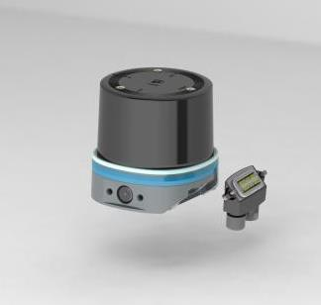
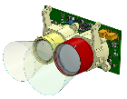
Features / Benefits
multiScan100
Customer Centric
Application-specific sensor setup: selectable measurement module, system plug, Apps and SW Add-ons
best sensor fit for the required application by only paying for the functions which are really needed.
… result in …
Feature
Benefit
Configurable sensor concept based on the application requirements (easy configuration by SICK Sales Configurator)
Selectable setup of measurement modules (starting with multiScan100136 - furthers launched in the future)
Selectable system plug (more system plugs available in the future)
Selectable Apps and Software Add-ons (continuous development of new functionalities)
Advantages
Measurement module
System plug
Apps & Add-ons

Slide 21
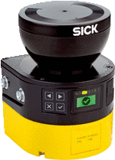
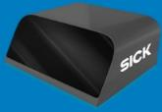
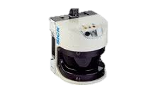
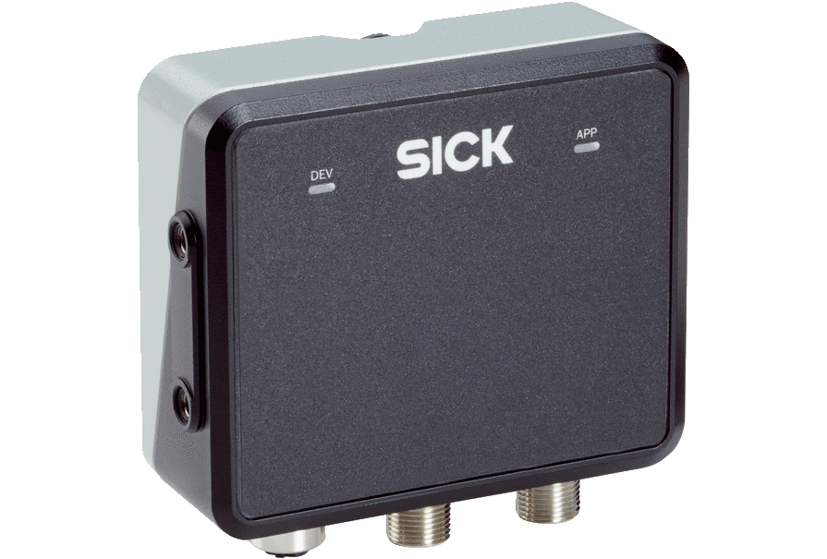
Portfolio view
Price
Safety Line (PL d)
*
Safety Line (PL b)
Software
multiScan100
Automation Line
Technology Line
* Future Option
Performance

Slide 22
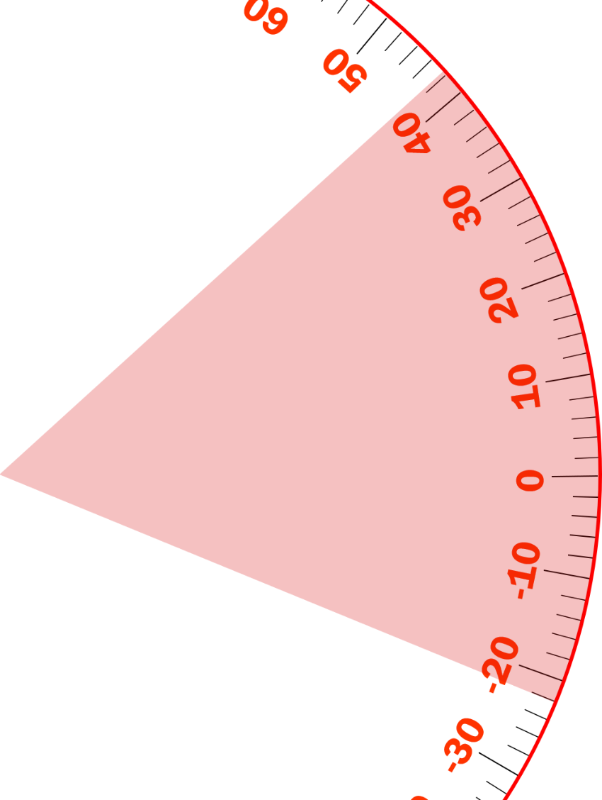
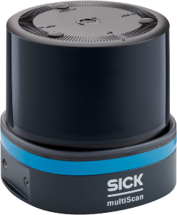
The multiScan100
Specification
FOV: 360° x 65° [-22.5° … +42.5°]
Ranges: 10%: 12 m I 90%: 30 m I max. on Reflector: 60 m
Horizontal angular resolution: 0.125° & 1°
Vertical angular resolution: 2.5° & 5°
Height: 98.5 mm
Scan frequency: 20 Hz I Response time one scan: ≤ 50 ms
Statistical error: ± 50 mm I System. Error: ≤ 20 mm
diameter: 100.3 mm
Beam divergency: 0.3° (Spot size sensor optics cover: 13 mm)
Operating temperature: - 30 … +50 °C

Slide 23
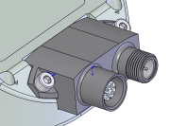
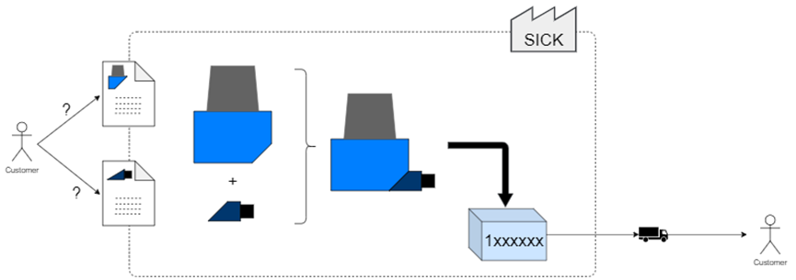
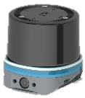
Modular Concept
Configured & software-defined offering
Measurement module
System plug
Apps & Add-ons
Improved customization possibilities
Pre-configuration
Customized connectivity
Pre-mounting
Sales configurator
Application optimized software
Tailored performance
Ease of product selection

Slide 24
multiScan100
Web server GUI
Simple and flexible configuration
Enhanced Diagnostics
Operating system independent, only web browser is needed
Standard for upcoming SICK LiDARs to create a common operating entity experience

Slide 25
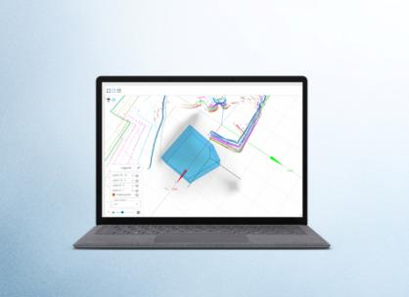
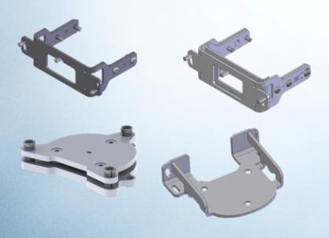
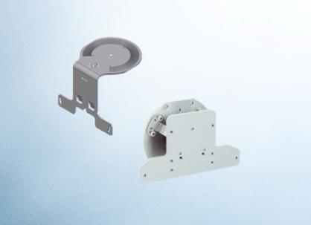
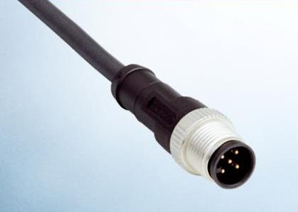
Accessories
multiScan100
Software / web server
Simple and flexible configuration
Enhanced Diagnostics
Brackets
Standard bracket
Alignment bracket
Fine alignment bracket
Mounting plate
Environmental Protection
Protective optics cover
Shock absorber
Cables
Ethernet connection: M12 4-pin (female connector)
Power/Synch. output connection: M12 5-pin (male connector)

Slide 26
multiScan100 Detect, localize and secure - all in one
Compact
reliable
Reliable
Customer Centric

Slide 27
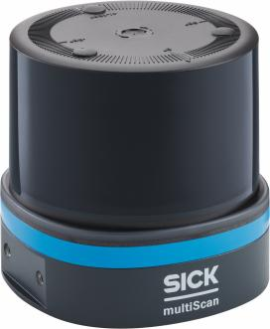
Thank you!
multiScan100

Slide 28
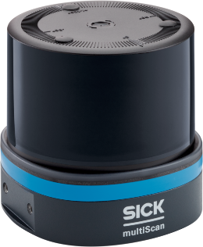
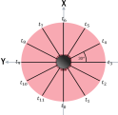
multiScan100 overview
Specifications
Working range | ≤ 0.05 … 60 m²⁾ … 30 m @ 90% … 12 m @ 10%
Aperture angle | 360°
Field of view | Hor.: 360° Vert.: 65° [-22.5°…+42.5°]
Scanning frequency | 20 Hz
Angular resolution | Hor.: 0.125° & 1° Vert.: 2.5° & 5°
Statistical error (1σ) | ≤ 20 mm
Systematic error | ± 50 mm¹⁾
Scan field flatness | Nav. layer (0°): ± 0.5° Other layers: ± 1°
Ambient light immunity | 100 klx
Operating temp. | - 30 … +50 °C / - 40 … +70 °C*
Enclosure rating | IP65 & IP67 & IP69k
Performance level (in preparation) ** |  | EN ISO 13849-1:2015
Algorithms & Apps
Web-Server GUI
Choice of Streaming or / & Field Evaluation App, … and many more!
Segmented data output
Multi Echo evaluation (three echo's)
Reflector recognition
Advanced filter options
Diagnosis functions, e.g. screen contamination indication, IMU
Choice of optimized data formats
Support of data aggregation tools, e.g.
Over the Air (OTA) update tool**
Ruggedized design
Shock & Vibration:
Advanced 1 & Advanced 2 *
EMC:
EN 61000-6-2 & EN 61000-6-3
Connectivity modular, rotatable, configurable
System plug concept
Supported interfaces
Power 9…30 V DC
Ethernet TCP/IP & UDP, 100 Mbit/s
Up to 8 configurable IOs
Ethernet TCP/IP & UDP, 1 Gbit/s**
CANopen / SAE J1939**
Automotive Ethernet 100BASE-T1 / BroadR-Reach**
¹⁾ Depending on range, ambient light, temperature etc. ²⁾ Extended range on reflectors *with accessory ** future options
Notes:
IMU: SOPAS Telegram - Polling or continuous streaming

Slide 29
Durability!
Mechanical robustness levels
Category | LEVEL “advanced 2” | LEVEL “advanced 1”
Vibration resistance | (IEC 60068-2-6:2007) Sine resonance scan: 10…1.000 Hz; 1 g Sine test: 10…500 Hz; 10 g; 10 cycles (IEC 60068-2-64:2008) Noise test: 10…500 Hz, 13.5 g^{RMS}, 5 h | (IEC 60068-2-6:2007) Sine resonance scan: 10…1.000 Hz; 1 g Sine test: 10…500 Hz; 5 g; 10 cycles (IEC 60068-2-64:2008) Noise test: 10…250 Hz, 4.24 g^{RMS}, 5 h
Shock resistance | (IEC 60068-2-27:2008) 100 g, 6 ms; ±3 shocks / axis 40 g, 6 ms; ±4.000 bumps / axis 50 g, 3 ms; ±5.000 bumps / axis | (IEC 60068-2-27:2008) 50 g, 11 ms; ±3 shocks / axis 25 g, 6 ms; ±1.000 bumps / axis 50 g, 3 ms ;±5.000 bumps / axis
How to reach? | Device mounted to SICK shock absorber bracket | Robustness by device design

Slide 30
Information about Data format
multiScan100 and other LiDARs
Type | Info | Advantages | Limitations
MSGPCK (data format) | available for UDP and TCP/IP outputs segments (e.g. 30° is one segment) contains information like device Identification / serial number, time stamp and device status requires about ~10 Mbit for picoScan (3 echoes) ~70 Mbit for multiScan100 (3 echoes) | easy to integrate with existing "libraries" Easy to parse ROS drivers also use this protocol Each field has a kind of "speaking name" or numbering | quite a lot of bandwidths requires more computing power, especially for parsing
COMPACT (data format) | available for UDP and TCP/IP outputs segments (e. g. 30° is one segment) similar to other 3D LiDAR Data format approaches contains information like device Identification / serial number, time stamp and device status Requires ~5 Mbit for picoScan (3 echoes) ~35 Mbit for multiScan100 (3 echoes) | very efficient much smaller band with needed "memcpy" will do the job → super efficient and resource-saving a bit like CoLa B | Data is not "self-describing" more "difficult" to parse (needs probably more integration time on customer side)
ROS (driver) | ROS1 & ROS2 | Easy integration, widely used open-source platform | Requires installation of ROS kernel
C++ (driver) |  | Low-level integration, open for a bunch of operation systems and CPU architectures | More complex approach

Slide 31
Measuring data with Quality!
Choice of different data formats & drivers
Type | Info | Advantages | Limitations
MSGPCK (data format) | available for UDP and TCP/IP outputs segments (e.g. 30° is one segment) contains information like device Identification / serial number, time stamp and device status requires about ~10 Mbit for picoScan (3 echoes) ~70 Mbit for multiScan100 (3 echoes) | easy to integrate with existing "libraries" Easy to parse ROS drivers also use this protocol Each field has a kind of "speaking name" or numbering | quite a lot of bandwidths requires more computing power, especially for parsing
COMPACT (data format) | available for UDP and TCP/IP outputs segments (e. g. 30° is one segment) similar to other 3D LiDAR Data format approaches contains information like device Identification / serial number, time stamp and device status Requires ~5 Mbit for picoScan (3 echoes) ~35 Mbit for multiScan100 (3 echoes) | very efficient much smaller band with needed "memcpy" will do the job → super efficient and resource-saving a bit like CoLa B | Data is not "self-describing" more "difficult" to parse (needs probably more integration time on customer side)
ROS (driver) | ROS1 & ROS2 | Easy integration, widely used open-source platform | Requires installation of ROS kernel
C++ (driver) |  | Low-level integration, open for a bunch of operation systems and CPU architectures | More complex approach

Slide 32
Application software
Modular concept
“Standard” Sensor Apps
Measurement data streaming
Object detection – 2D or 3D **
&
& with PL b rating
Feature Add-ons
Multi Echo
Reflector recognition
Filter package robustness (rain, fog, particles)
Filter package data reduction & pre-processing
“Specialized” Sensor Apps
LiDAR-LOC2 **
Safe break assist

Slide 33
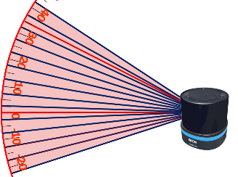
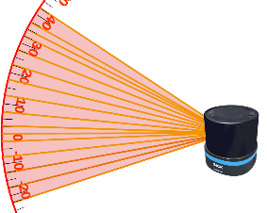
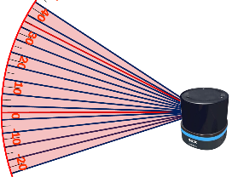
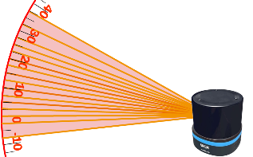
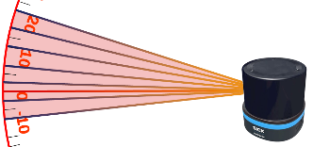
Product range (technology)
multiScan100 - Roadmap: Version overview
multiScan136
16 scan layers
2 layers with 1/8° and 14 layers with 1°
FoV: 65° x 360°
Range:
Operating range: 30 m
extended reflector range up to 60m
multiScan100-2
16 scan layers
16 layers with 1/2°
FoV: 42.5° x 360°
Range:
Operating range: 60 m
multiScan100-3
16 scan layers
16 layers with 1/2°
FoV: 65° x 360°
Range:
Operating range: 60 m
multiScan136S
16 scan layers
2 layers with 1/8° and 14 layers with 1°
FoV: 65° x 360°
Range:
Operating range: 30 m
multiScan100-4
8 scan layers
Horizontal angular resolution: TBD
FoV: 30° x 360°
Range:
Operating range: 60 m
Q1 / 2023
Q2 / 2023
Q3 / 2023
4
tba
5
tba
1
2
3

